Slide 1


Holepunch: Secure Deletion from Puncturable Pseudorandom Functions

Slide 2




Secure Deletion
Secure deletion ensures that deleted files are irrecoverable by an adversary that later obtains physical access to the underlying storage medium.
User interacts with storage device
Adversary obtains physical access
to storage device
DISK
Threat Model: Prevent recovery of deleted files from an adversary that obtains unfettered physical access to the storage device
WRITE
DELETE

Slide 3
Storage Medium as a Black Box
Prior work showed that securely deleting data is impossible when treating the underlying physical storage medium as a black-box since the operating system cannot guarantee that:
Physical blocks are not duplicated on storage
Logical blocks map directly to physical blocks
Solution: Bootstrapping secure deletion with an external master key vault! (EuroS&P’18 - Eraser: Your Data Won’t Be Back)
Onarlioglu, K., Robertson, W., & Kirda, E. (2018, April). Eraser: Your Data Won't Be Back. In 2018 IEEE European Symposium on Security and Privacy (EuroS&P) (pp. 153-166). IEEE.

Slide 4

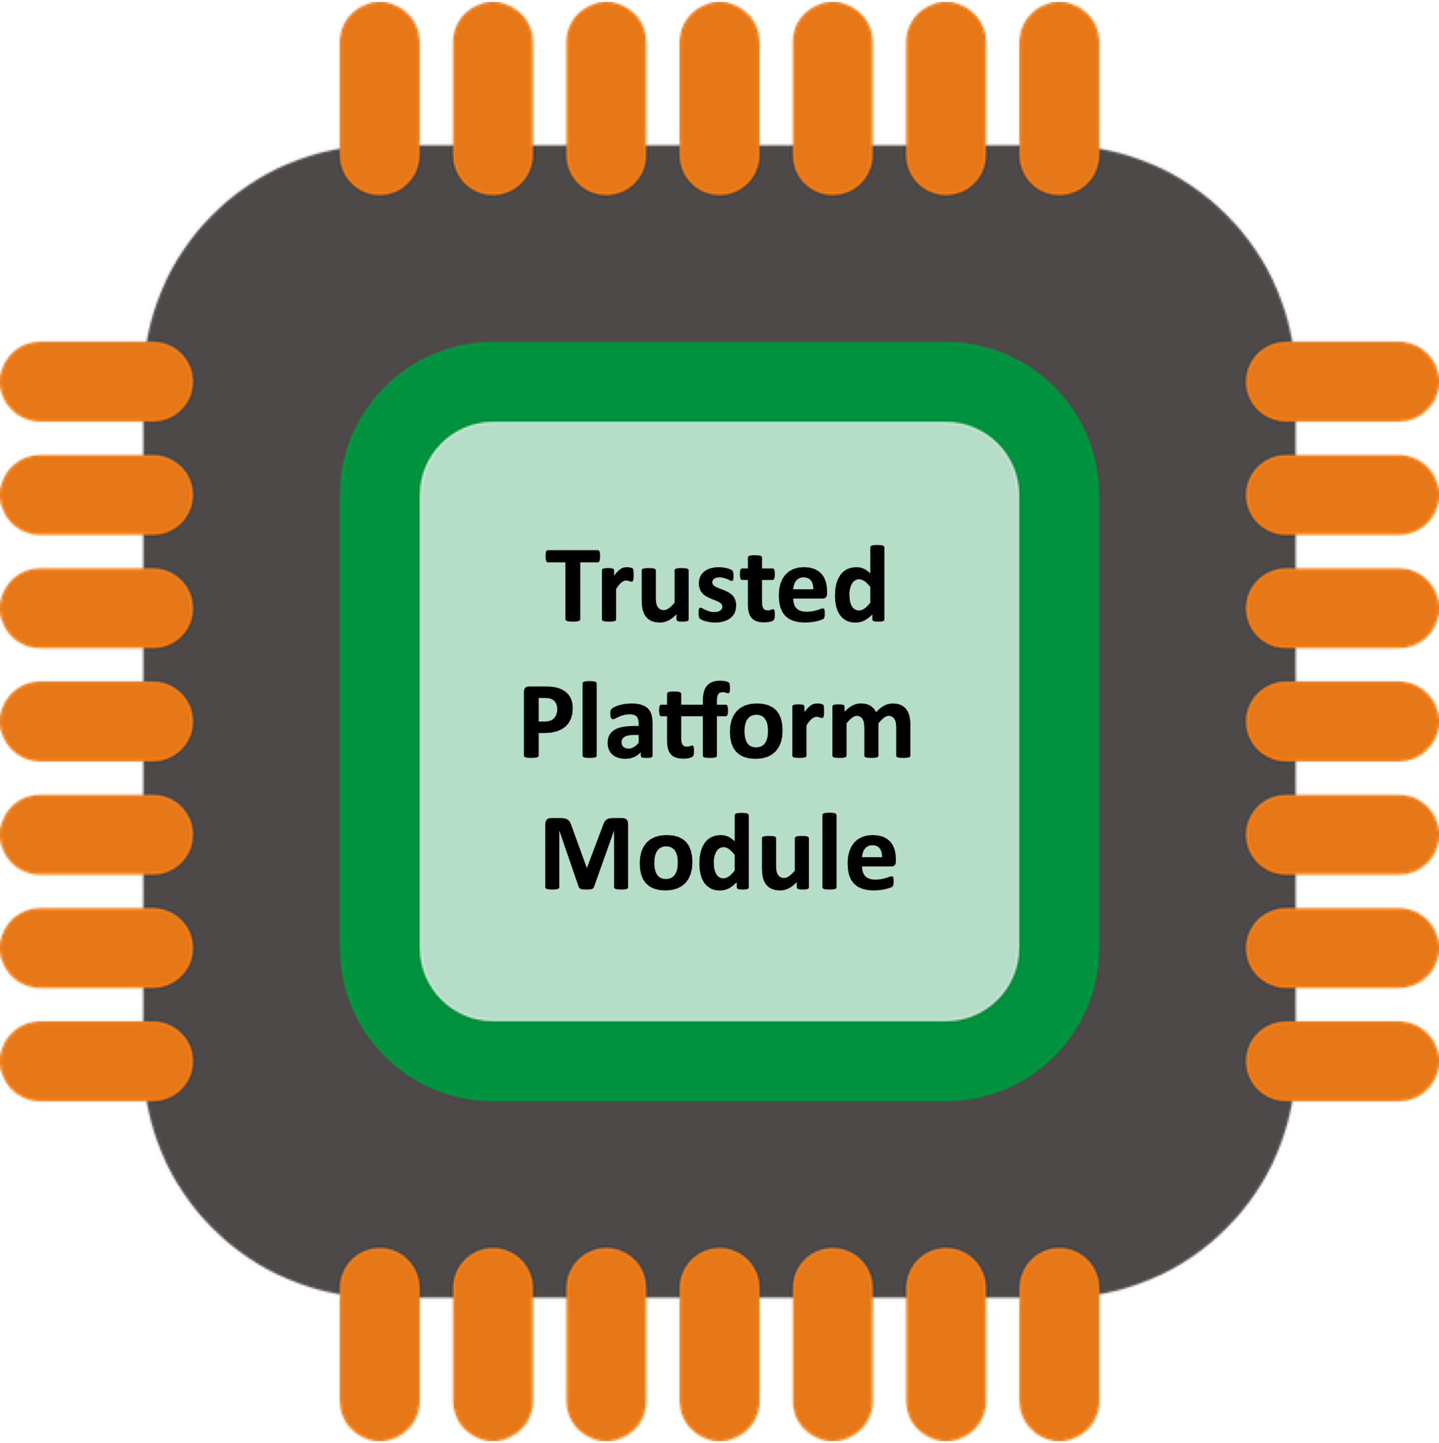



Bootstrapping Secure Deletion [ORK’18]
Use external storage device (e.g., TPM or Smart Card) as a trusted master key vault
WRITING FILES
Request Master Key from TPM
DISK
File A
1.) Generate file encryption key
2.) Encrypt file with file encryption key
3.) Encrypt file key with master key
Master Key is never persisted to disk!
4.) Write encrypted file and encrypted file key to disk

Slide 5

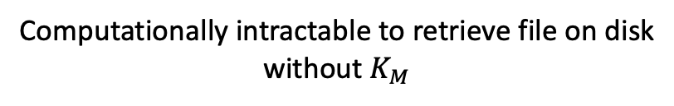
Bootstrapping Secure Deletion [ORK’18]
Use external storage device (e.g., TPM or Smart Card) as a trusted master key vault
DELETING FILES
Refresh Master Key
DISK
File A
Computationally intractable to retrieve file on disk
without $K_{M}$

Slide 6
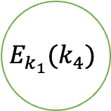
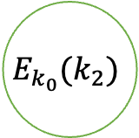

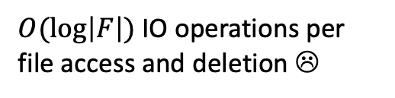
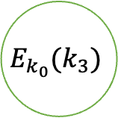
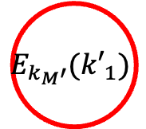
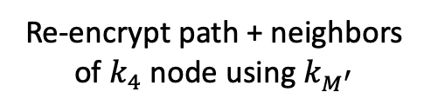

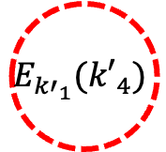
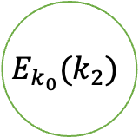
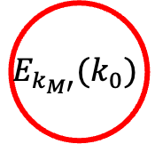
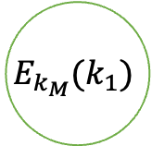

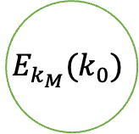
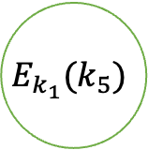
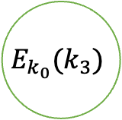

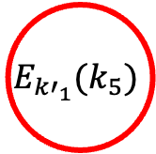
Tree-Based Approaches For Key Storage
Eraser (ORK’18) used novel file key tree (FKT) design to avoid encryption amplification on file deletions
Delete file encrypted under $k_{4}$
$$k_{M′}$$
$$k_{M}$$
File Key Tree (FKT)
DISK
Re-encrypt path + neighbors of $k_{4}$ node using $k_{M^{′}}$
$$E_{k_{M′}}(k_{0})$$
$$E_{k_{M}}(k_{0})$$
$$E_{k_{M}′}({k′}_{1})$$
$$E_{k_{M}}(k_{1})$$
Refresh Master Key
FKT can be large, so it’s stored on disk…
$$E_{k_{0}}(k_{2})$$
$$E_{k_{0}}(k_{2})$$
$$E_{k_{0}}(k_{3})$$
$$E_{k_{0}}(k_{3})$$
$$E_{{k′}_{1}}({k′}_{4})$$
$$E_{k_{1}}(k_{4})$$
$$E_{{k′}_{1}}(k_{5})$$
$$E_{k_{1}}(k_{5})$$
$O(\log\left|F\right|)$ IO operations per file access and deletion ☹
$\left|F\right|$ leaves

Slide 7
Can we do better?

Slide 8


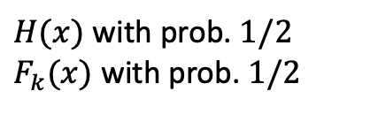
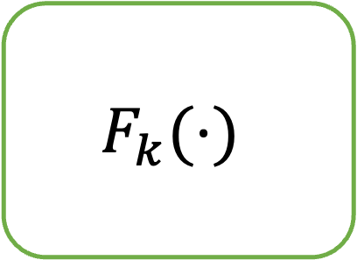
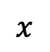
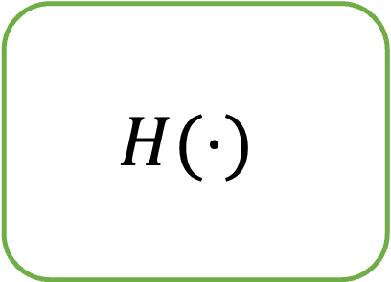
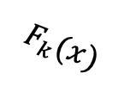
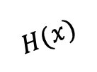
Recap: Pseudorandom Functions (PRF)
A “random looking” function
Black-box
$$H(⋅)$$
Any poly-time adversary has negligible advantage in distinguishing between the functions in the experiment!
Truly Random Function
$$H(x)$$
“I can’t tell the difference!”
$H(x)$ with prob. $1/2$
$F_{k}(x)$ with prob. $1/2$
$$F_{k}(⋅)$$
Pseudorandom Function
$$x$$
$$F_{k}(x)$$
Notes:
PRF experiment

Slide 9
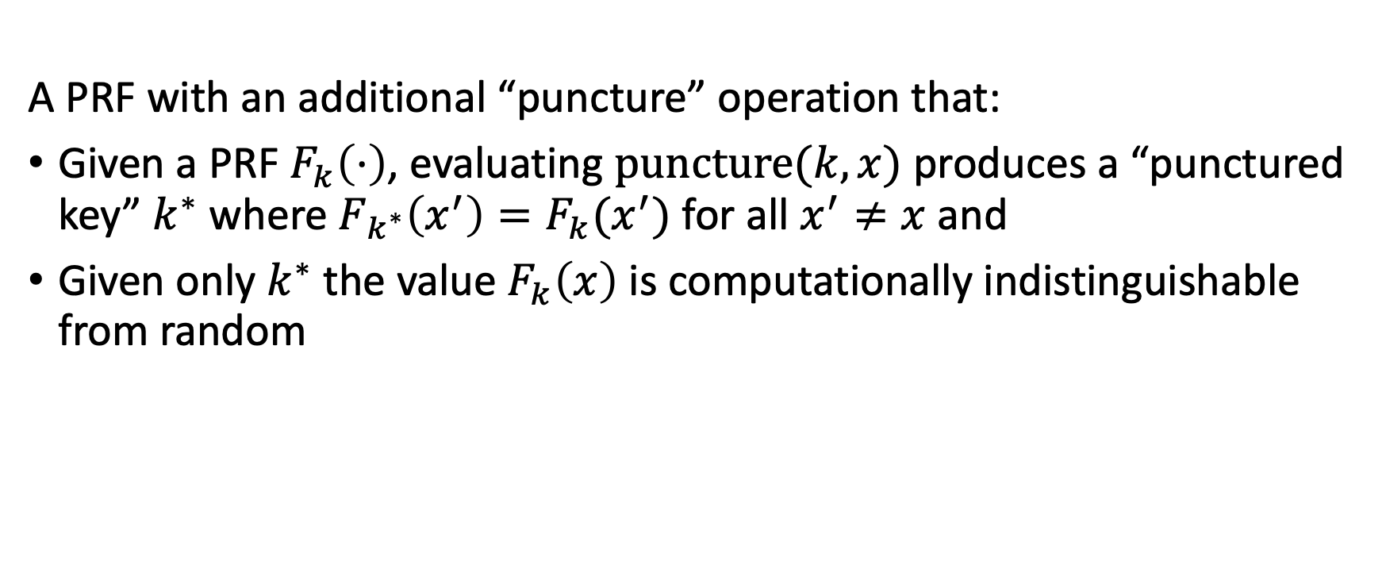
Puncturable Pseudorandom Functions (PPRF)
A PRF with an additional “puncture” operation that:
Given a PRF $F_{k}\left(⋅\right)$, evaluating $\text{puncture}(k,x)$ produces a “punctured key” $k^{∗}$ where $F_{k^{∗}}\left(x^{′}\right)=F_{k}(x^{′})$ for all $x^{′}≠x$ and
Given only $k^{∗}$ the value $F_{k}\left(x\right)$ is computationally indistinguishable from random

Slide 10
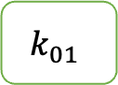

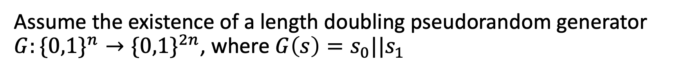
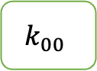
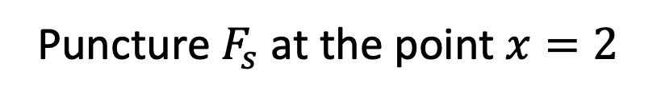
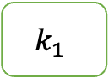
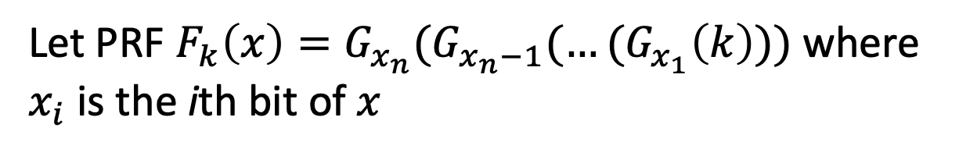
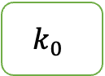
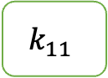
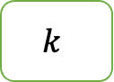
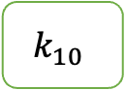
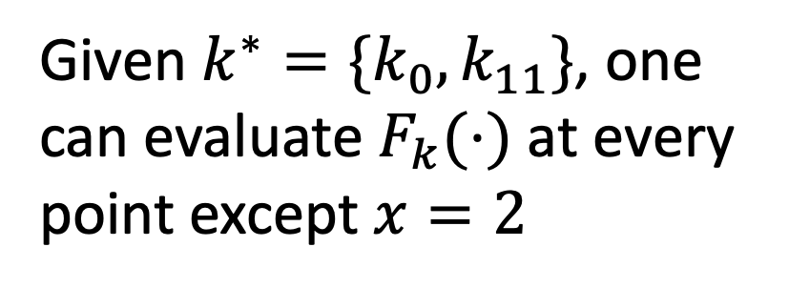
GGM’86 Puncturable PRF
Assume the existence of a length doubling pseudorandom generator $G:\{0,1\}^{n}→\{0,1\}^{2n}$, where $G\left(s\right)=s_{0}||s_{1}$
Let PRF $F_{k}\left(x\right)=G_{x_{n}}(G_{x_{n}−1}(…(G_{x_{1}}\left(k\right)))$where $x_{i}$ is the ith bit of $x$
$$k$$
$$k_{0}$$
$$k_{1}$$
Given $k^{∗}=\{k_{0},k_{11}\}$, one can evaluate $F_{k}(⋅)$ at every point except $x=2$
$$k_{00}$$
$$k_{01}$$
$$k_{10}$$
$$k_{11}$$
New key $s^{∗}$ are the neighbors along the path from $x=2$ to the root $k$
Goldreich, O., Goldwasser, S., & Micali, S. (1986). How to construct random functions. Journal of the ACM (JACM), 33(4), 792-807.
Puncture $F_{s}$ at the point $x=2$
Notes:
The GGM’86 PRF construction

Slide 11
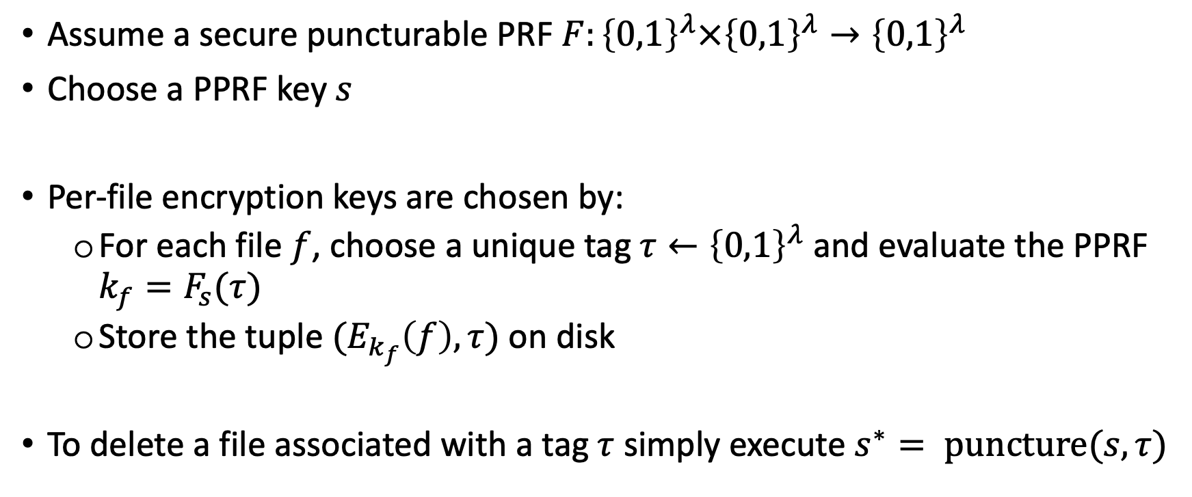
Holepunch: Secure Deletion from PPRFs
Assume a secure puncturable PRF $F:{\left\{0,1\right\}}^{λ}×{\left\{0,1\right\}}^{λ}→{\left\{0,1\right\}}^{λ}$
Choose a PPRF key $s$
Per-file encryption keys are chosen by:
For each file $f$, choose a unique tag $τ←{\left\{0,1\right\}}^{λ}$ and evaluate the PPRF $k_{f}=F_{s}(τ)$
Store the tuple $(E_{k_{f}}\left(f\right), τ)$ on disk
To delete a file associated with a tag $τ$ simply execute $s^{∗}= \text{puncture}(s, τ)$

Slide 12

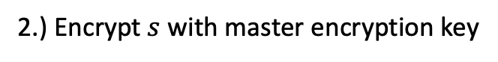
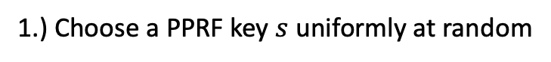
Holepunch: Initialization
Assume a PPRF $F$
Request Master Key from TPM
DISK
1.) Choose a PPRF key $s$ uniformly at random
2.) Encrypt $s$ with master encryption key
3.) Write encrypted PPRF key to disk
Master Key is never persisted to disk!

Slide 13
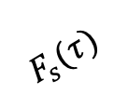
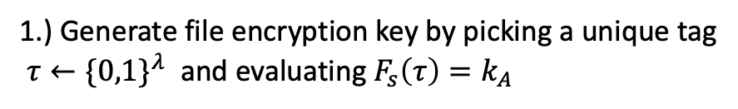

Holepunch: Writing Files
Assume a PPRF $F$
Request Master Key from TPM
$$τ$$
DISK
File A
$$F_{s}(τ)$$
1.) Generate file encryption key by picking a unique tag
$τ←\{0,1\}^{λ}$ and evaluating $F_{s}\left(τ\right)=k_{A}$
Retrieve encrypted PPRF key from disk
Decrypt PPRF key
2.) Encrypt file with file encryption key
3.) Write encrypted file and its tag to disk

Slide 14


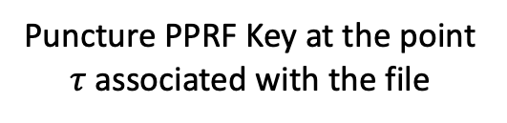
Holepunch: Deleting Files
Refresh Master Key
DISK
$$τ$$
File A
Puncture PPRF Key at the point $τ$ associated with the file
Then re-initialize by writing $E_{k_{M^{′}}}(s^{∗})$ to disk!

Slide 15
Conclusion
Puncturable PRF allows faster file reads and writes by minimizing disk IO
Some caveats that we glazed over here
what happens as punctured PRF key grows large?
See more details in paper draft!

Slide 16
Backup
Some technical stuff

Slide 17

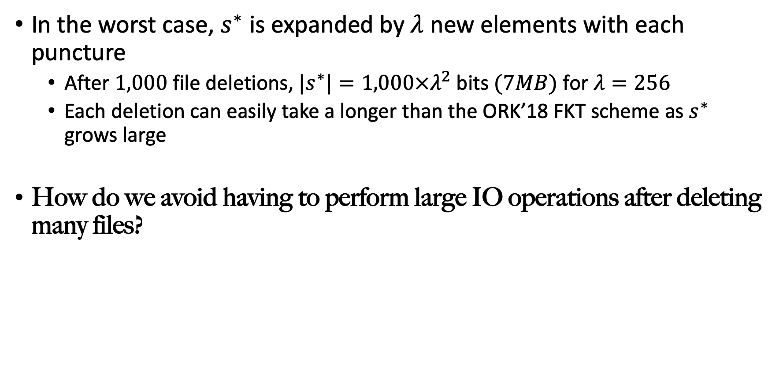
Challenges: Writing $s^{∗}$ to disk
In the worst case, $s^{∗}$ is expanded by $λ$ new elements with each puncture
After $1,000$ file deletions, ${|s}^{∗}|=1,000×λ^{2}$ bits $(7MB)$ for $λ=256$
Each deletion can easily take a longer than the ORK’18 FKT scheme as $s^{∗}$ grows large
How do we avoid having to perform large IO operations after deleting many files?

Slide 18
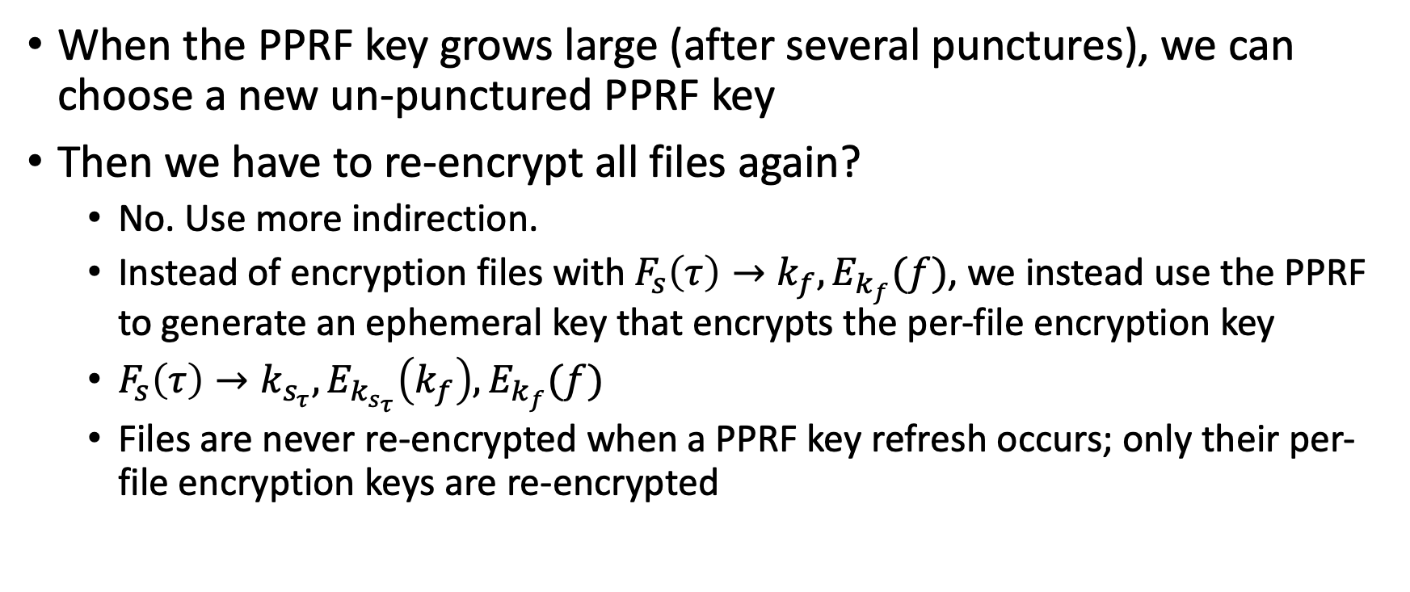
PPRF Key Refreshing
When the PPRF key grows large (after several punctures), we can choose a new un-punctured PPRF key
Then we have to re-encrypt all files again?
No. Use more indirection.
Instead of encryption files with $F_{s}\left(τ\right)→k_{f},E_{k_{f}}(f)$, we instead use the PPRF to generate an ephemeral key that encrypts the per-file encryption key
$F_{s}\left(τ\right)→k_{s_{τ}}, E_{k_{s_{τ}}}\left(k_{f}\right), E_{k_{f}}(f)$
Files are never re-encrypted when a PPRF key refresh occurs; only their per-file encryption keys are re-encrypted

Slide 19
Security Game

Slide 20


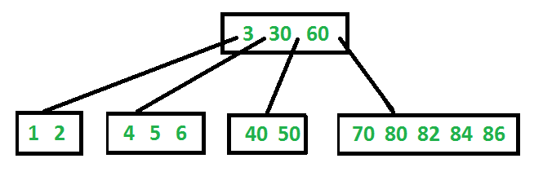
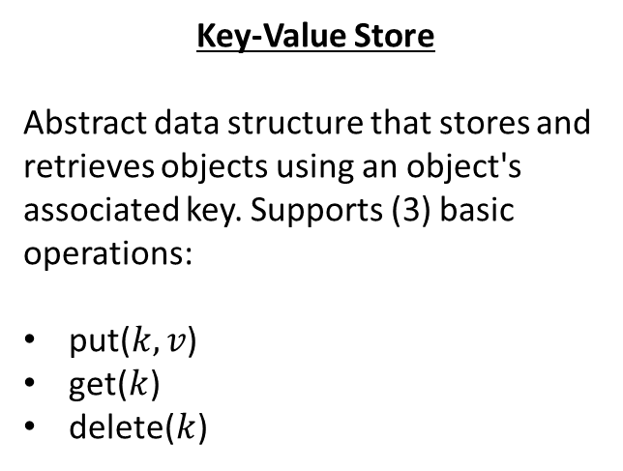
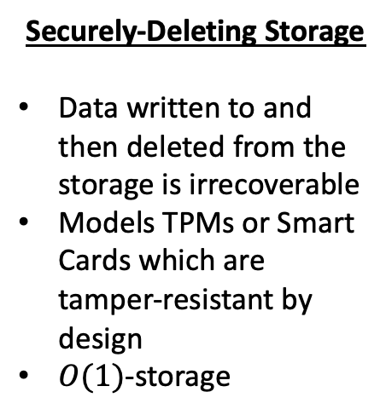
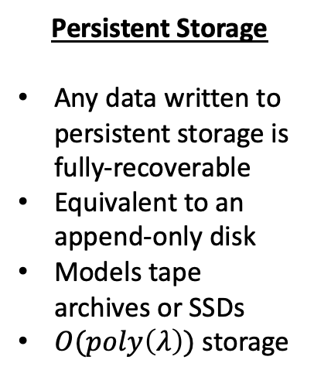
Notation
Securely-Deleting Storage
Data written to and then deleted from the storage is irrecoverable
Models TPMs or Smart Cards which are tamper-resistant by design
$O(1)$-storage
Persistent Storage
Any data written to persistent storage is fully-recoverable
Equivalent to an append-only disk
Models tape archives or SSDs
$O(poly\left(λ\right))$ storage
Key-Value Store
Abstract data structure that stores and retrieves objects using an object's associated key. Supports (3) basic operations:
put($k, v$)
get($k$)
delete($k$)

Slide 21
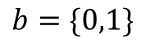
Security Game
(1)
Challenger
$$b=\{0,1\}$$
Key-Value Store
adversary

Slide 22
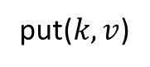
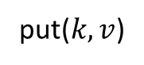
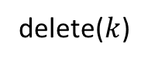




Security Game
(2)
Challenger
$$b=\{0,1\}$$
put($k, v$)
put($k, v$)
Key-Value Store
…
…
$$poly(λ)$$
interactions
delete($k$)
delete($k$)
adversary
put($k, v$)
put($k, v$)

Slide 23




Security Game
(3)
Challenger
$$b=\{0,1\}$$
$(k_{0}, v_{0})$, $(k_{1}, v_{1})$
put($k_{b}, v_{b}$)
Key-Value Store
$$poly(λ)$$
interactions
…
…
adversary
delete($k_{b}$)
(4) REPEAT
Repeat steps (2) & (3) $poly(λ)$ times

Slide 24


Security Game
(5)
Challenger
$$b=\{0,1\}$$
$$b′$$
Key-Value Store
$1$ if $b=b′$
$0$ otherwise
adversary

Slide 25

Computationally Secure Deletion
We say a key-value store implements computationally secure deletion if for all polynomial-time adversaries, the advantage in the security game is negligible
$$\left|Pr\left[b=b^{′}\right]−\frac{1}{2}\right|≤negl(λ)$$

